Slide 1
Big Data Technology Final Project
Course: Big data technology (cs-523)
Professor: Mrudula Mukadam

Slide 2
Weather Data Streaming, Analysis and visualization
Group Members
Thanh Do Nguyen
Van Ngoc Trau Nguyen
Mihret Ghebremichael Kidane
Melaku Gossaye Denbel
Big data technology (cs-523)

Slide 3
Contents
Overview
Kafka & Spark Streaming
Hive & Spark SQL
Visualization with Tableau
Demonstration
Big data technology (cs-523)

Slide 4

Technology
Big data technology (cs-523)

Slide 5
OVERVIEW > DATASET
WeatherAPI is a powerful fully managed free weather and geolocation API provider that provides extensive APIs that range from the weather forecast, historical weather, future weather, weather alerts, air quality data, IP lookup, and astronomy through to sports, time zone, and geolocation.
The main objectives of this project are:
Create an end-to-end pipeline that will extract and use real-time weather data from WeatherAPI.com and save it temporarily in HDFS
Analyse the saved Weather data to get an insight
Visualize the streaming data and provide various insights

Slide 6
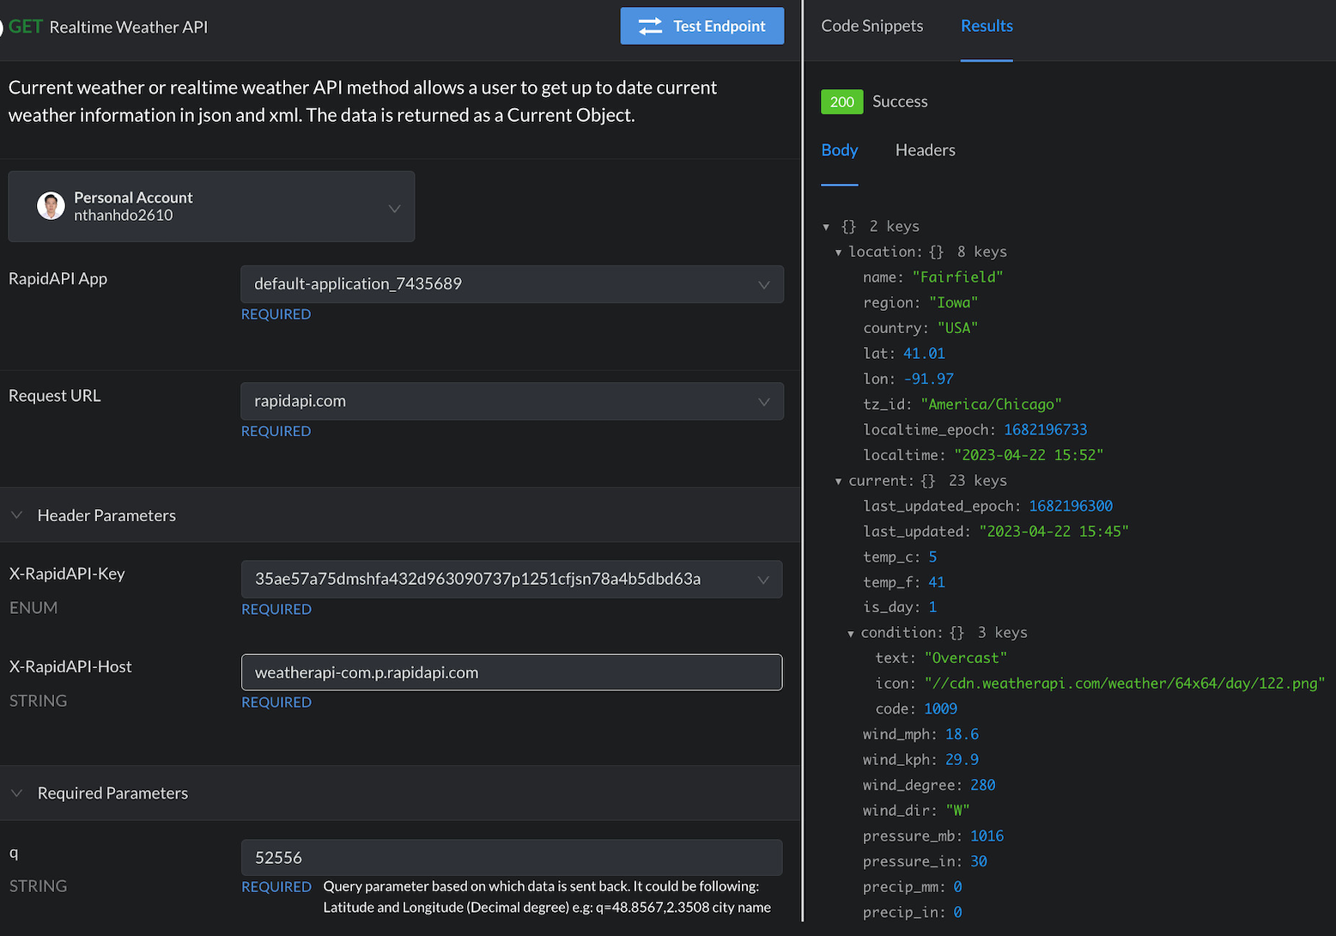
OVERVIEW > DATASET
Sample API:
https://weatherapi-com.p.rapidapi.com/current.json

Slide 7
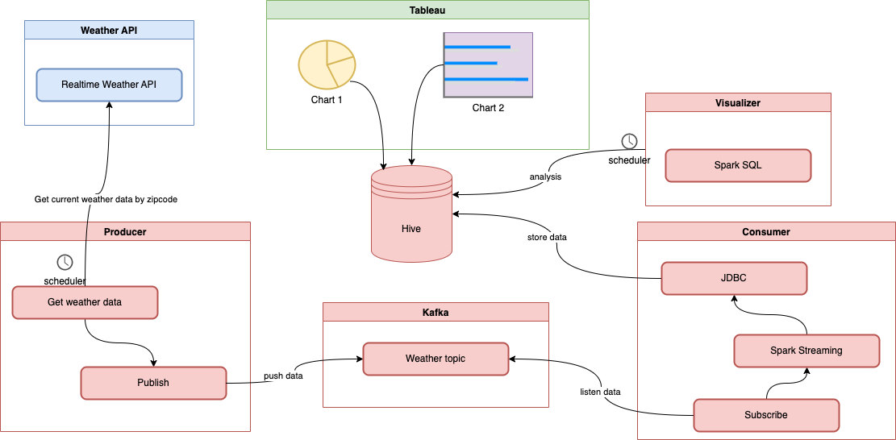
OVERVIEW > Workflow

Slide 8
Kafka & Spark Streaming
Why ?
A distributed streaming platform: real-time data streaming technology capable of handling trillions of events per day
Publish and subscribe to a stream of records
Fault-tolerant
Process records as they occur in the stream
Source: https://kafka.apache.org/uses

Slide 9
Hive & Spark SQL
Why ?
Manipulating large sets of distributed data
Structured data
Enable to write SQL
Designed for OLAP
Connect through JDBC
What to do ?
Use Spark SQL to query the data from Hive tables
Save the results into Hive as Tables or Views
We can use that results to visualize
Source: https://hive.apache.org/, https://spark.apache.org/sql/

Slide 10


Visualization with Tableau
It is a visual analytics platform transforming the way we use data to solve problems—empowering people and organizations to make the most of their data.
Important features:
Informative Dashboards
Supports numerous data sources
Connectivity with Live and In-Memory Data
10
Big data technology (cs-523)

Slide 11
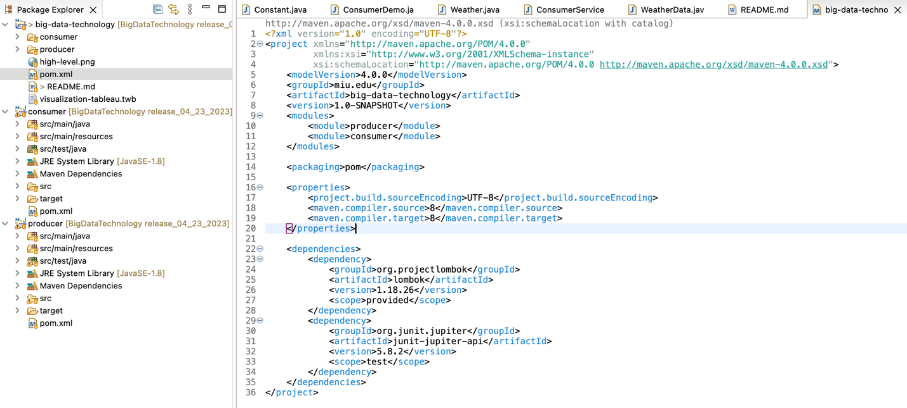
Demonstration > project structure
Use Maven for a general project, including producer and consumer projects as modules

Slide 12
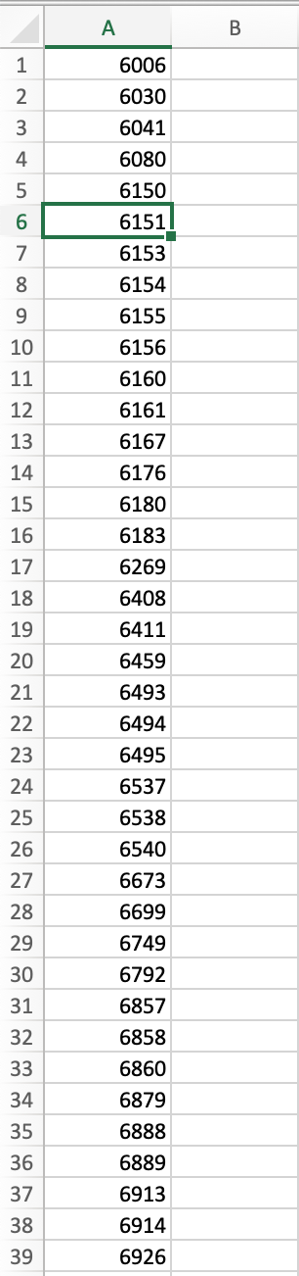
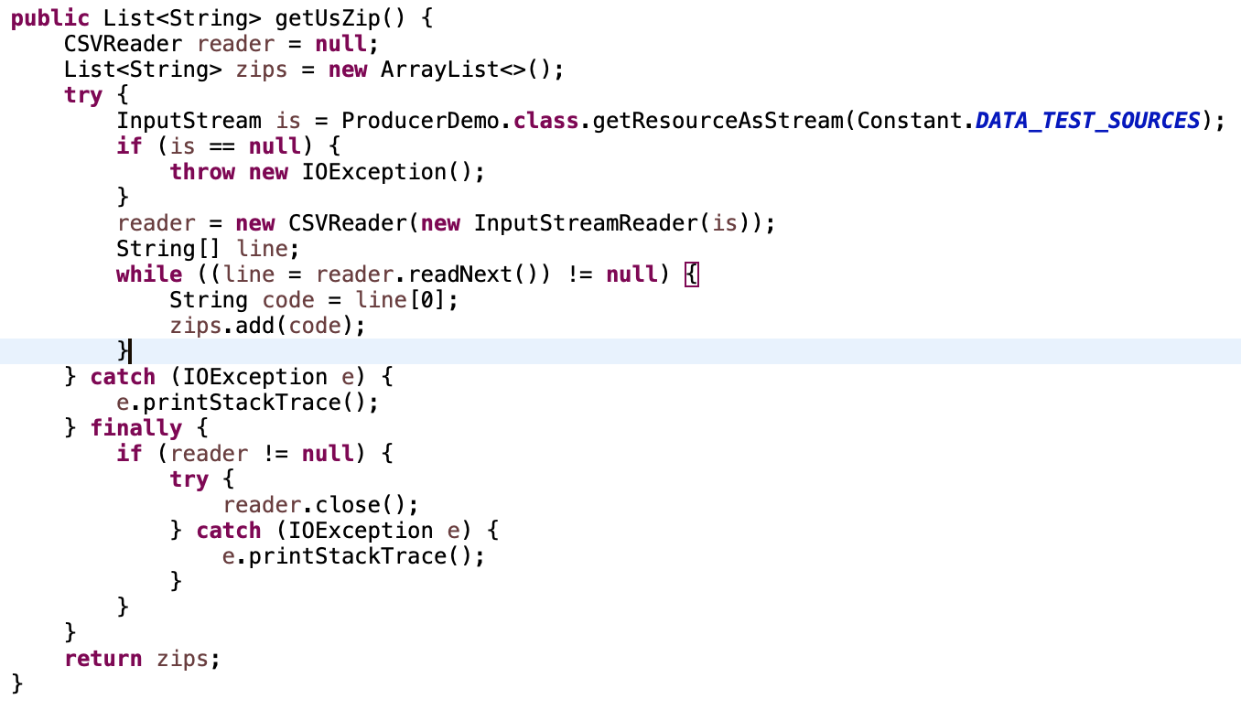
Demonstration > Producer
Using CSVReader to read zipcodes from csv file

Slide 13
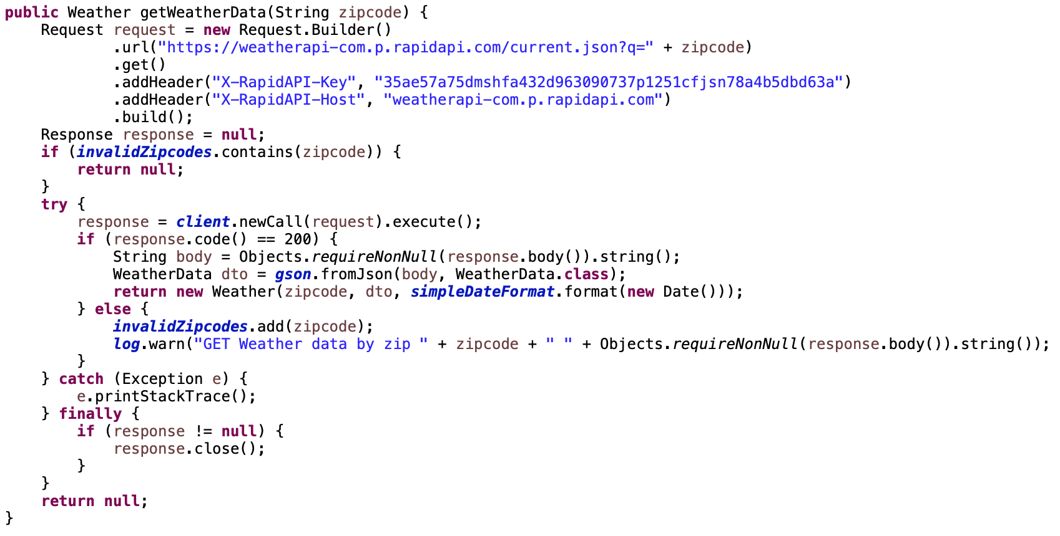
Demonstration > Producer
Get real-time Data from Weather API by zipcode
If the zip code is unsupported to get Weather data from API, we will ignore it in the next schedule.

Slide 14
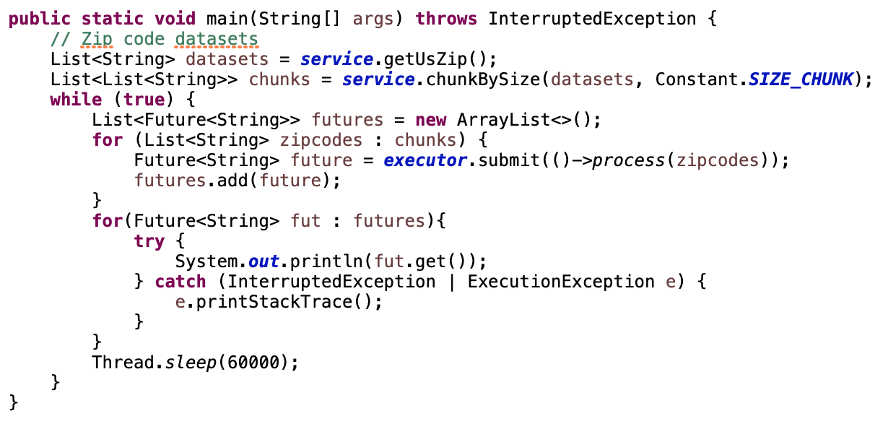
Demonstration > Producer
Run multi-thread to get Weather data

Slide 15
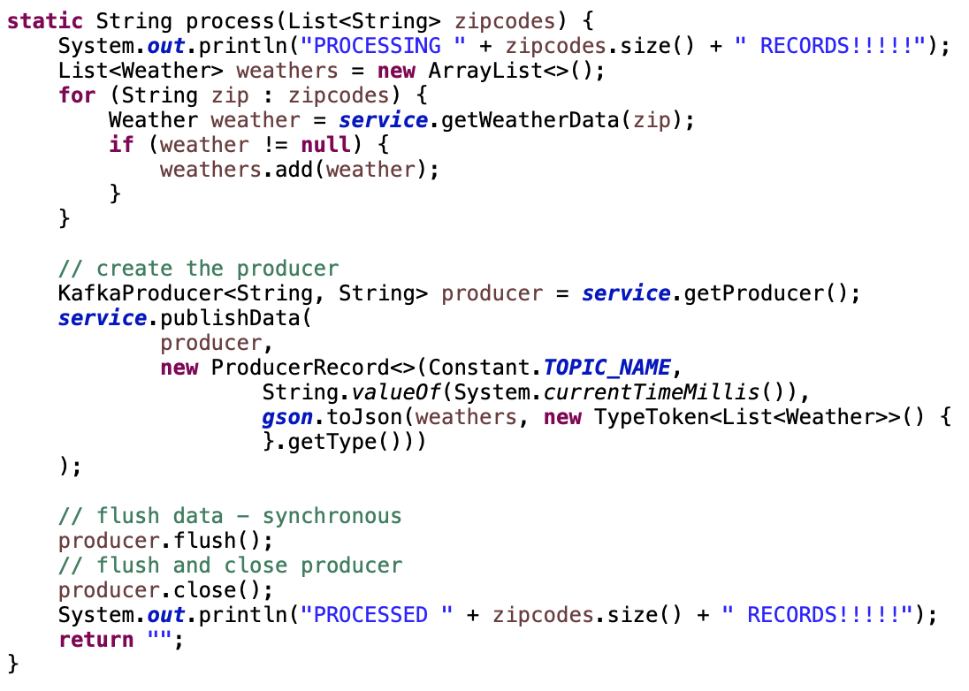
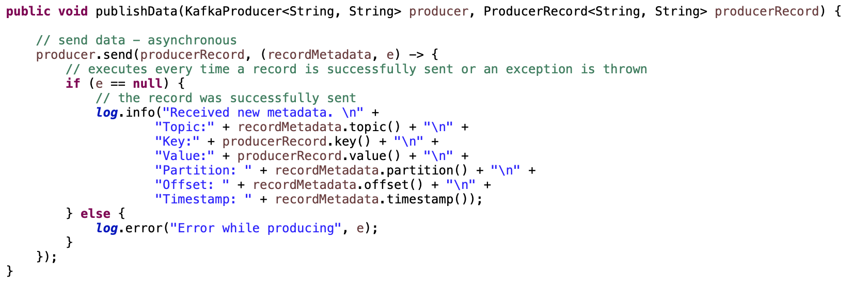
Demonstration > Producer
KafkaProducer publishes data block (not single record) to Consumer

Slide 16
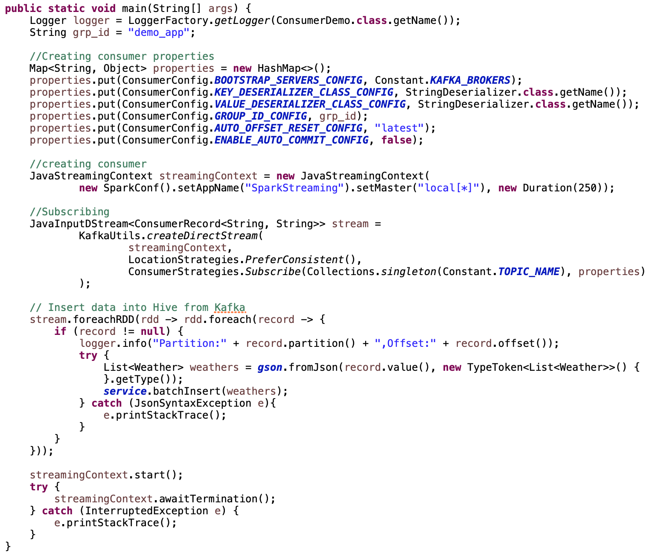
Demonstration > Consumer
Streaming data using Spark
Insert data into Hive from Kafka

Slide 17
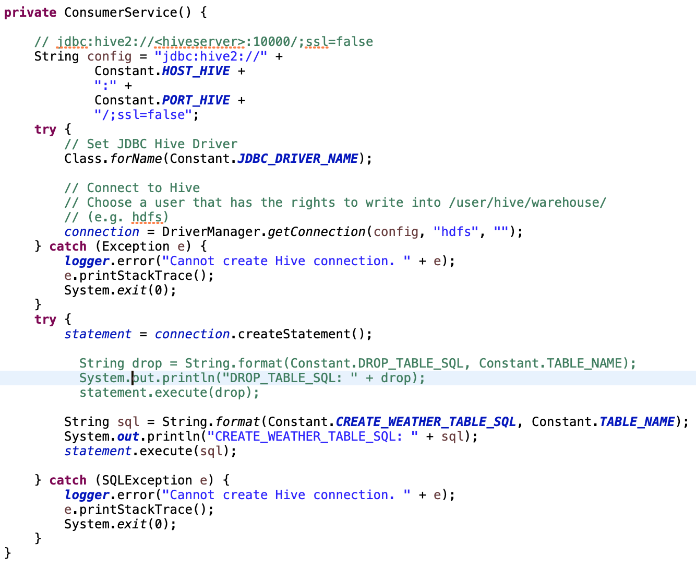
Demonstration > Hive
Connect to Hive using JDBC

Slide 18
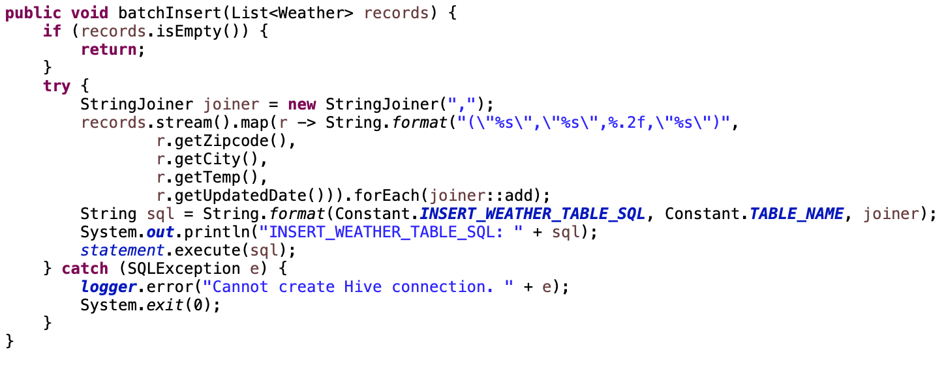
Demonstration > Hive
Batch insert data (not single record) into Hive

Slide 19
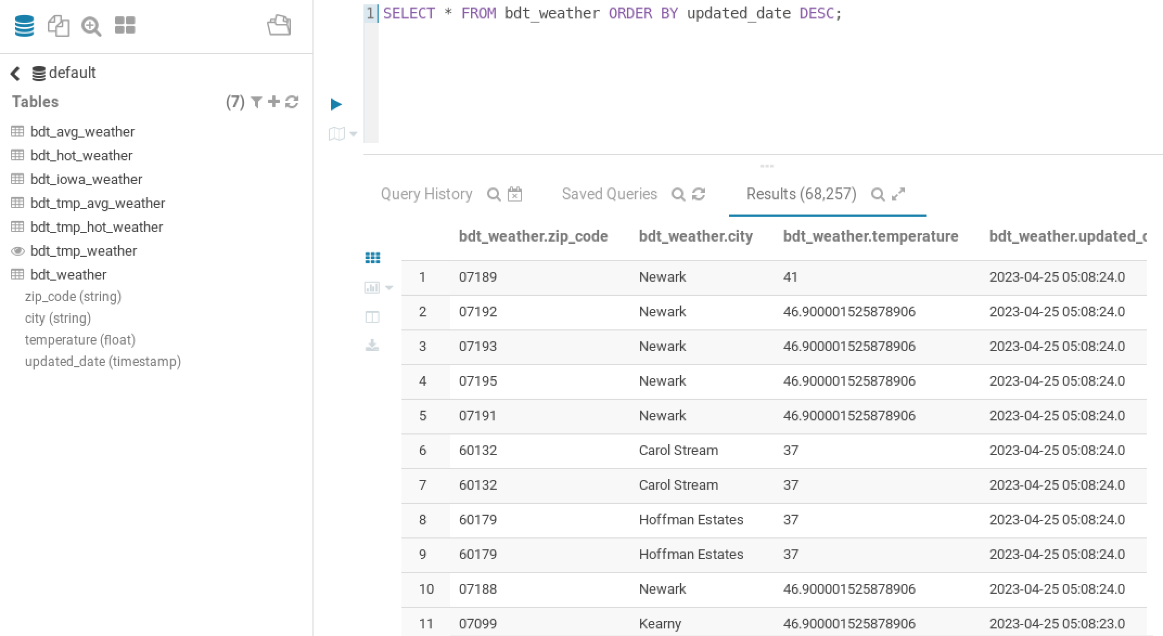
Demonstration > Hive

Slide 20
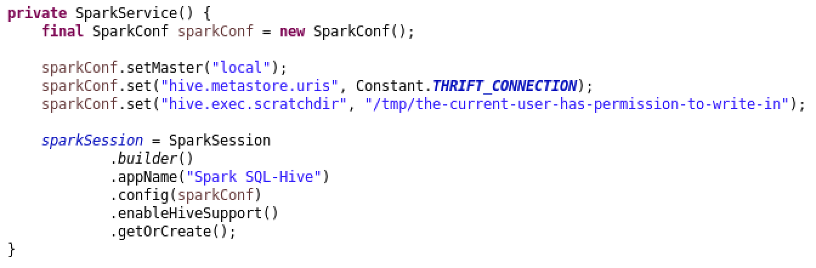
Demonstration > SPARKSQL & Hive
Connect to Hive
Set permission to write

Slide 21
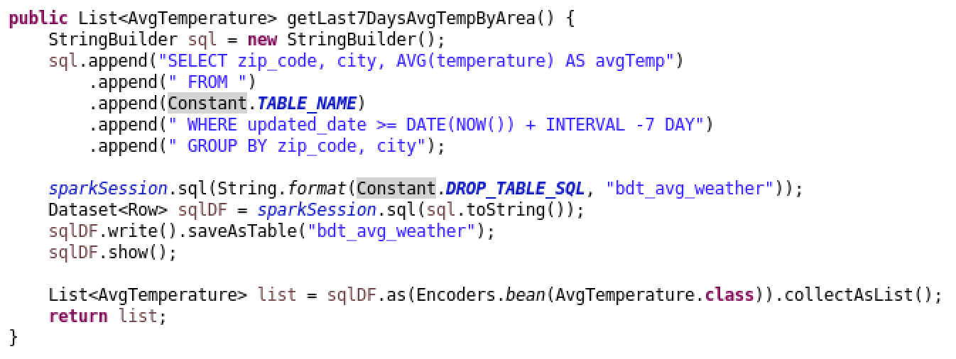
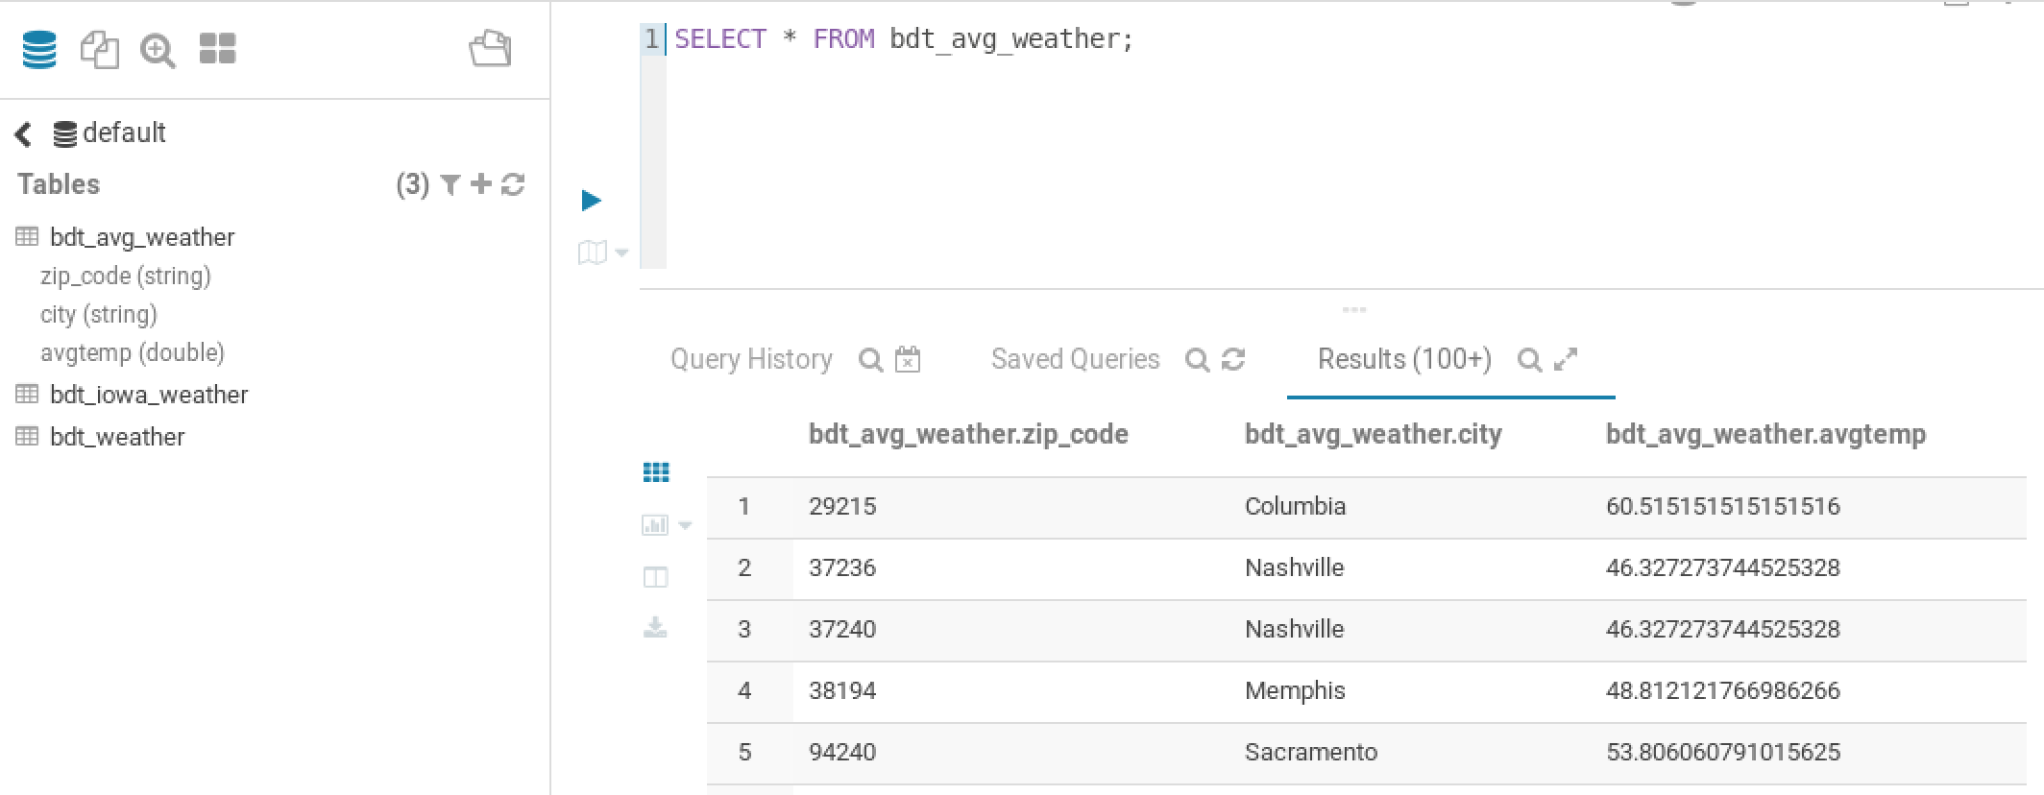
Demonstration > SPARKSQL & Hive
Enable to write SQL
Well-supported

Slide 22
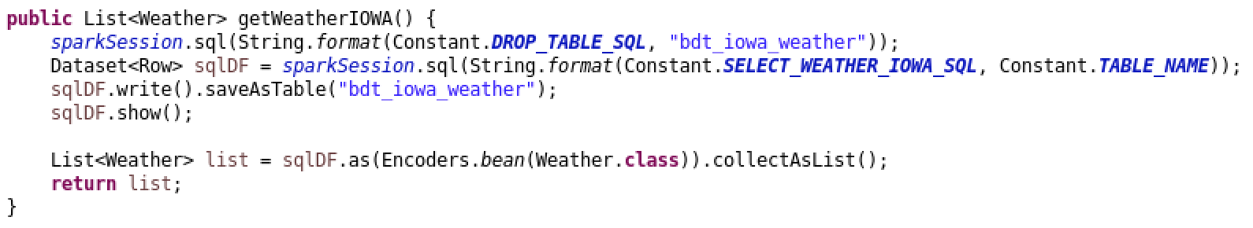
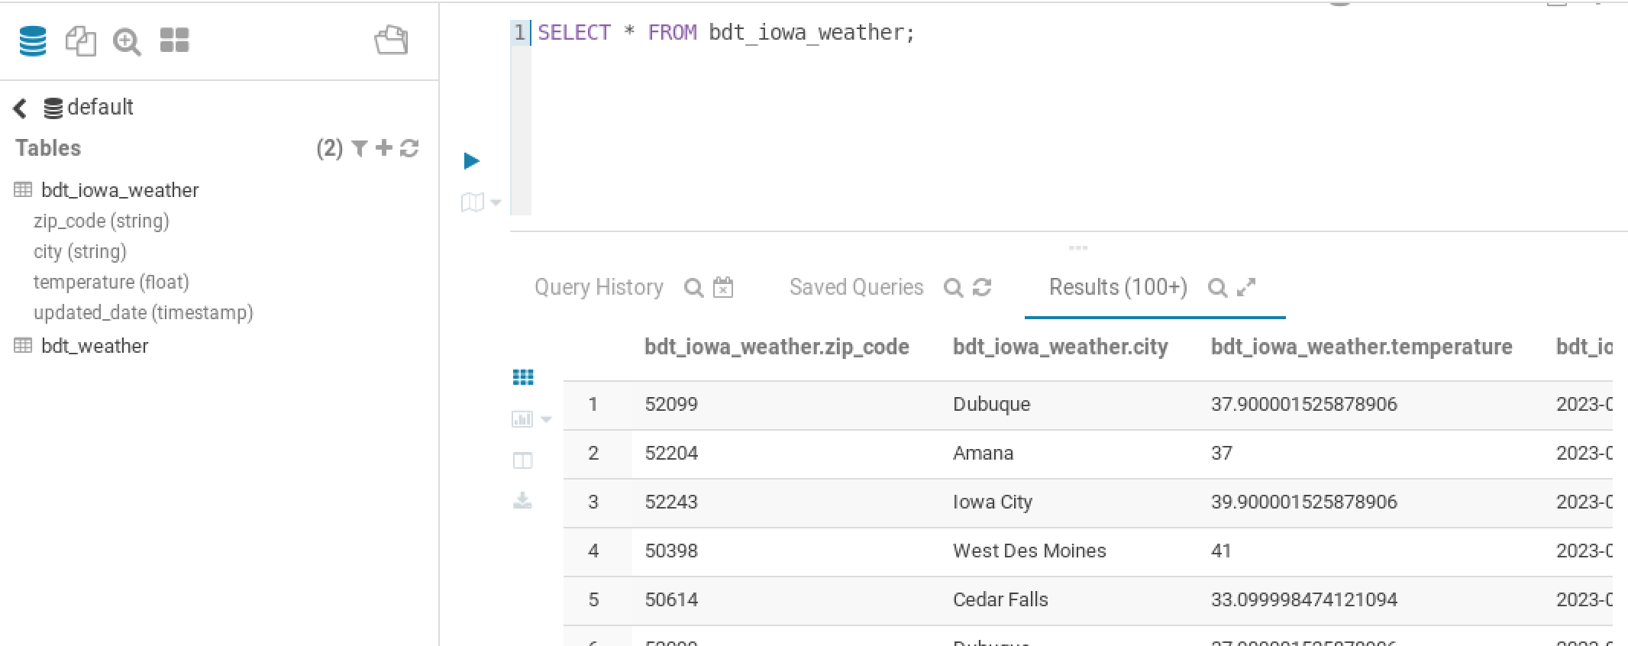
Demonstration > SPARKSQL & Hive

Slide 23
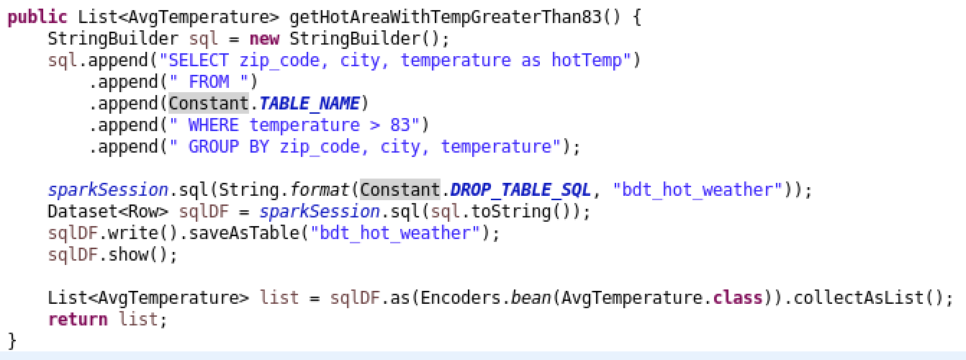
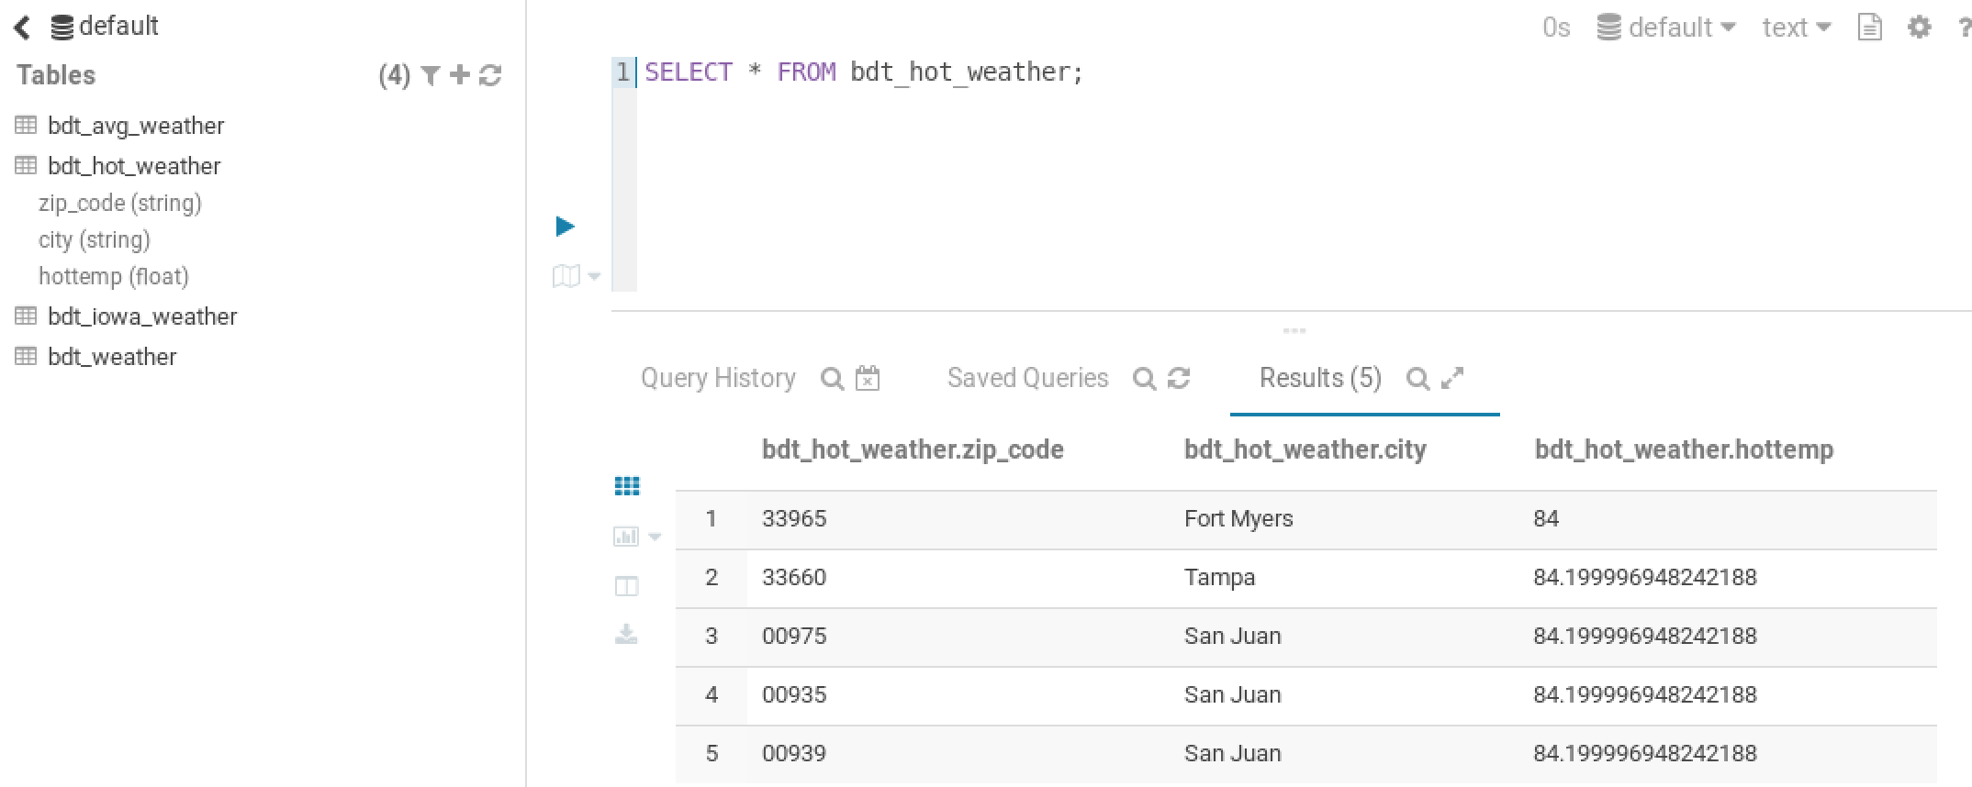
Demonstration > SPARKSQL & Hive

Slide 24
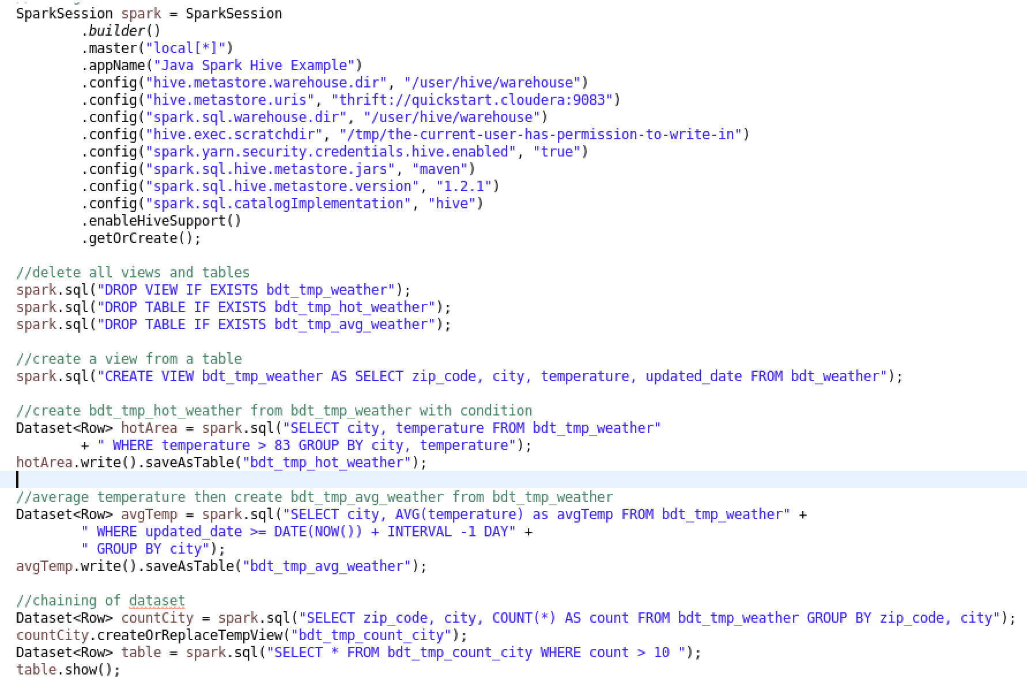
Demonstration > SPARKSQL & Hive

Slide 25
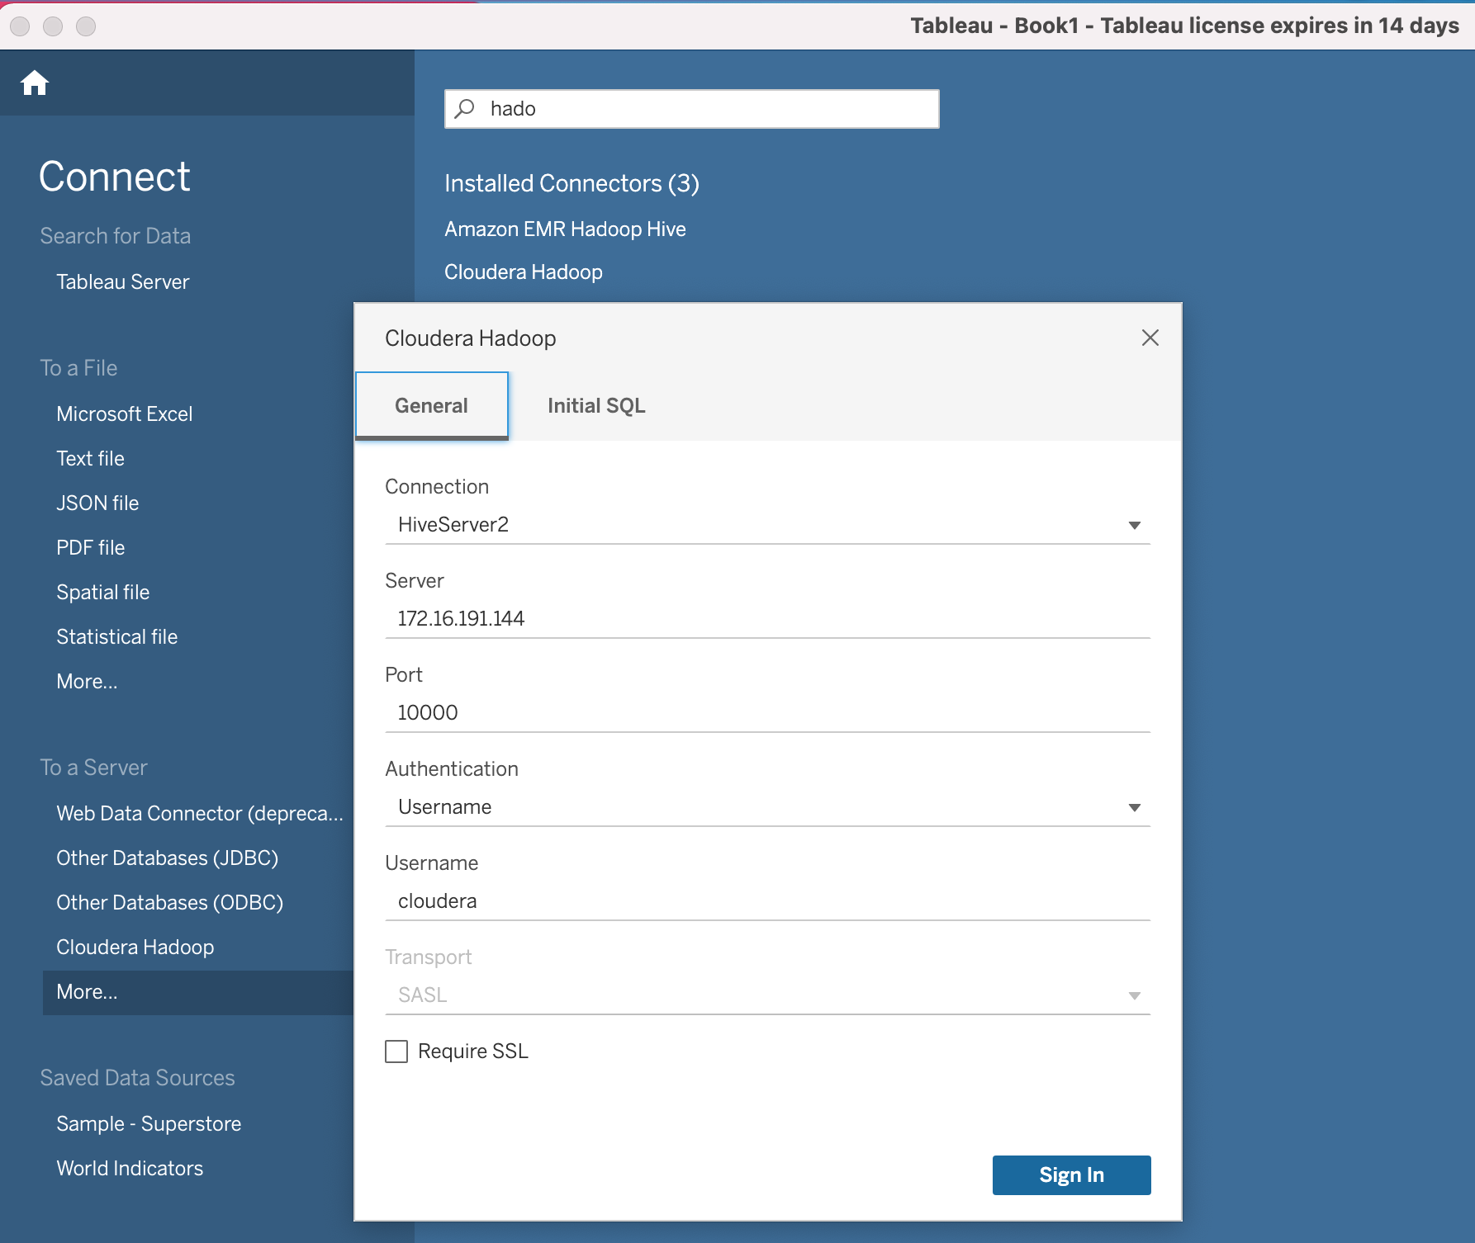
Demonstration > Tableau
Support driver to connect Hive through ODBC

Slide 26
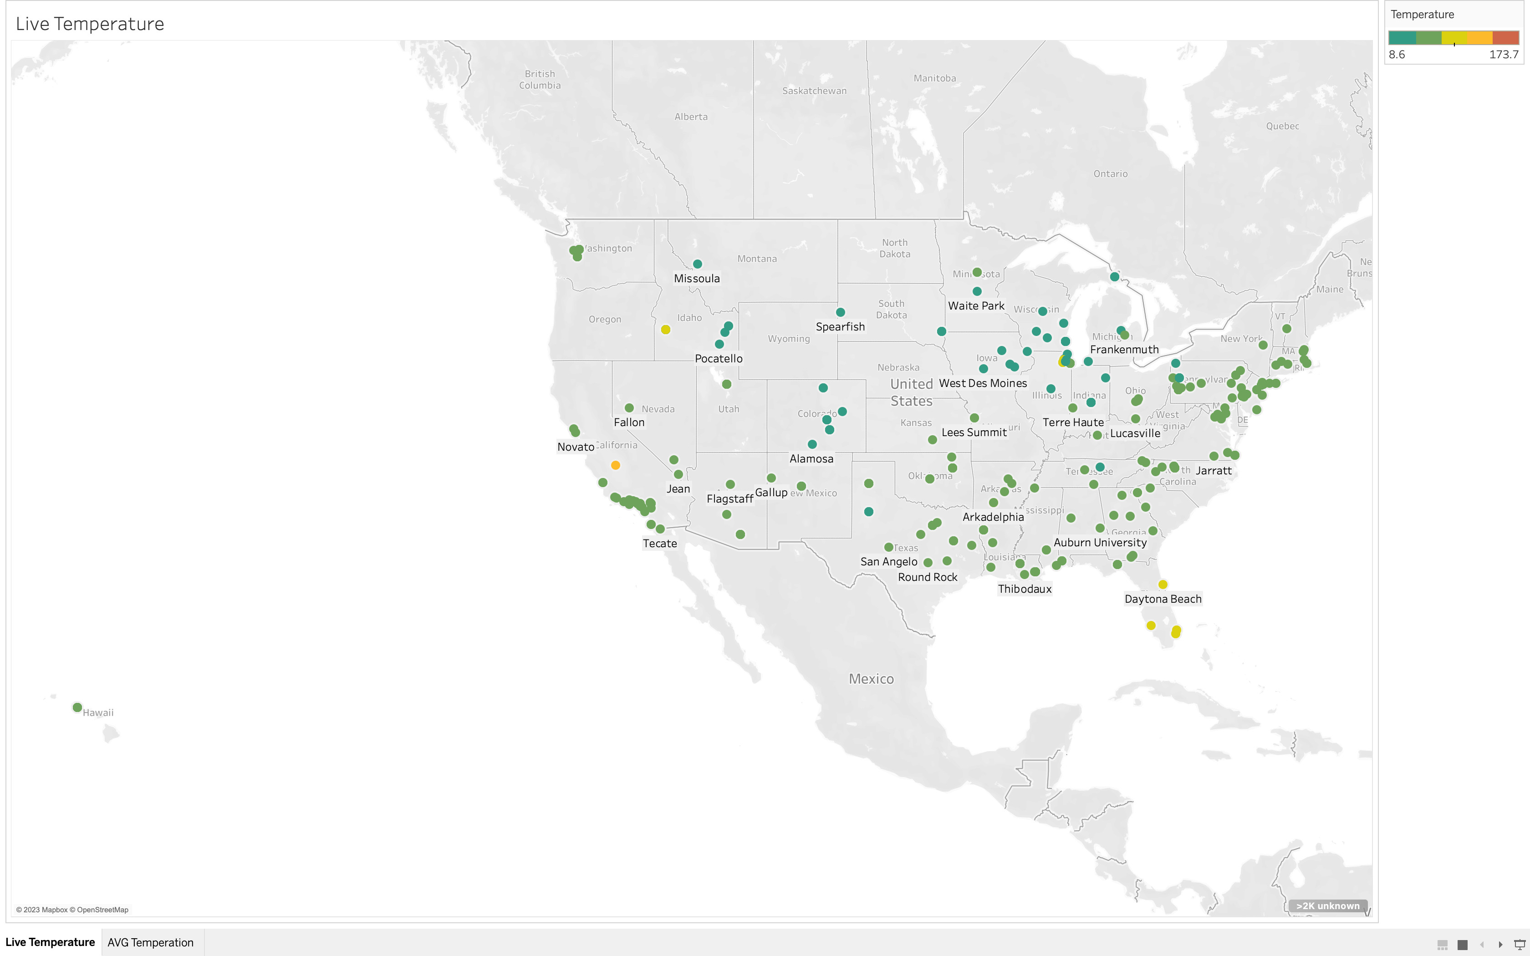
Demonstration > Tableau
Easy to visualize data
Customize a wide range of graph types
Live Temperature map

Slide 27
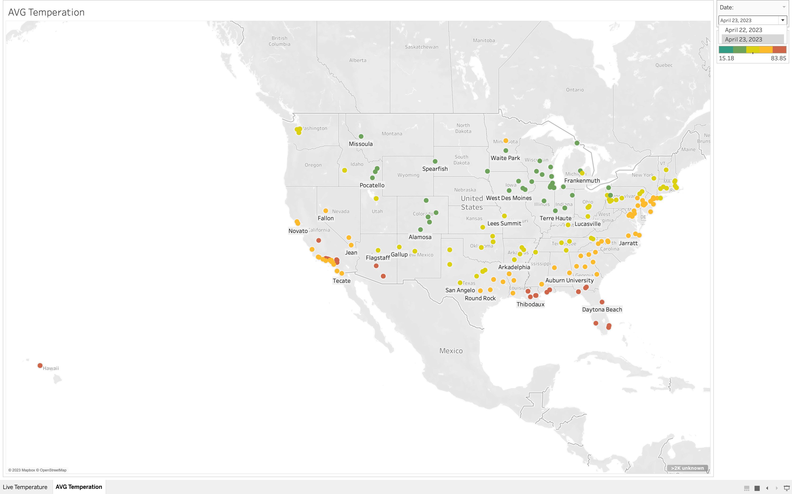
Demonstration > Tableau
AVG Temperature map

Slide 28
Demonstration > Live Demo

Slide 29
Thank you for listening

